Slide 1


Final Dissertation
bachelor degree in computer science
a web graphical user interface for the
packet-loss-concealment testbench tool
Student Stefano Dallona | Supervisor Prof. Luca Turchet | Co-Supervisor Ing. Luca Vignati

Slide 2
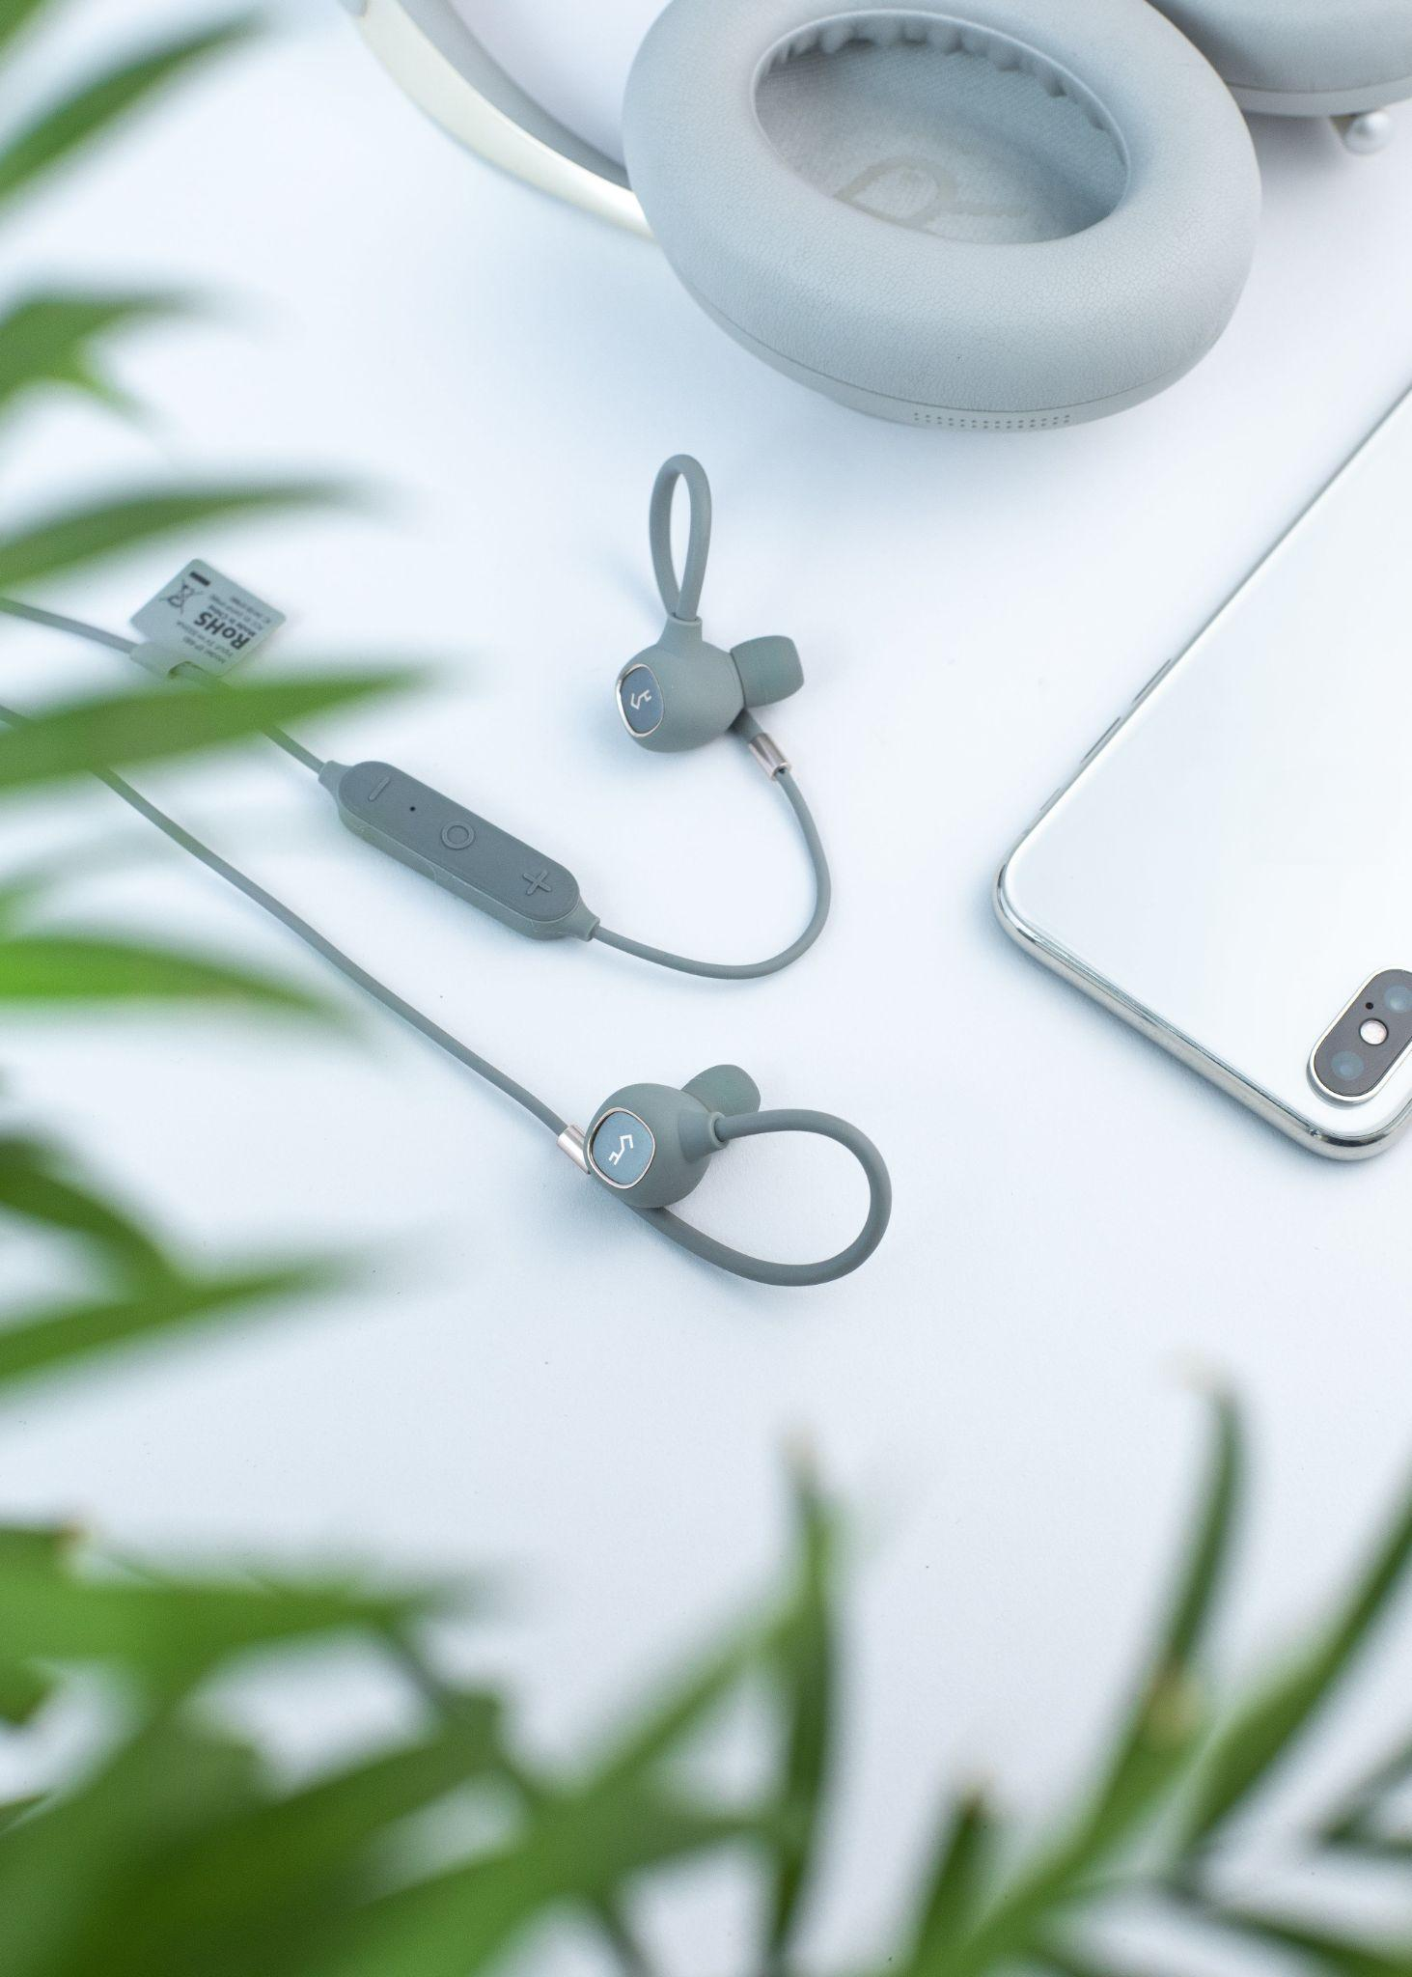
Introduction
1
Context
PLC Testbench, a tool for the comparison of Packet Loss Concealing algorithms
2
Problem
Interaction difficult due to the lack of a graphical user interface available
3
Solution
Development of a graphical user interface

Slide 3

Purpose of the Thesis
Develop a Graphical User Interface for the PLC Testbench tool
in order to support
QUANTITATIVE and QUALITATIVE
comparison of PLC algorithms

Slide 4
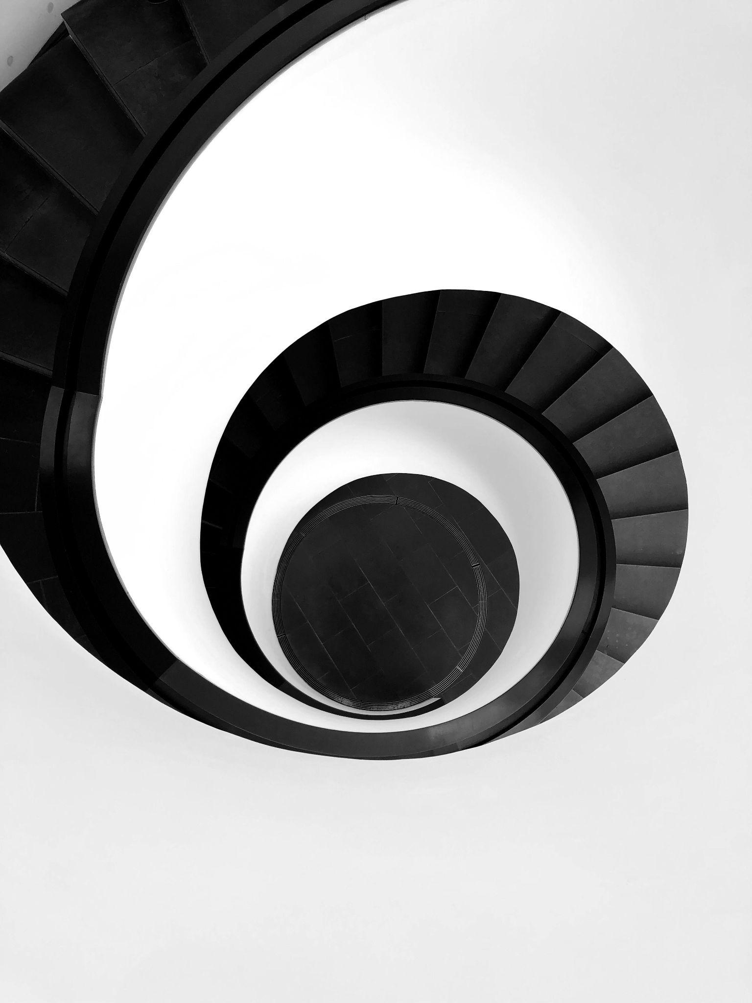
Methodology
Iterative development process
to
shorten release cycles / fast feedback
minimize risk of useless development
1
2
N
Design
Design
Design
…
Testing
Develop
Testing
Develop
Testing
Develop

Slide 5





Technologies
React frontend widgets | Flask backend RESTful API | Docker packaging & containerization | Circle CI build & deploy

Slide 6
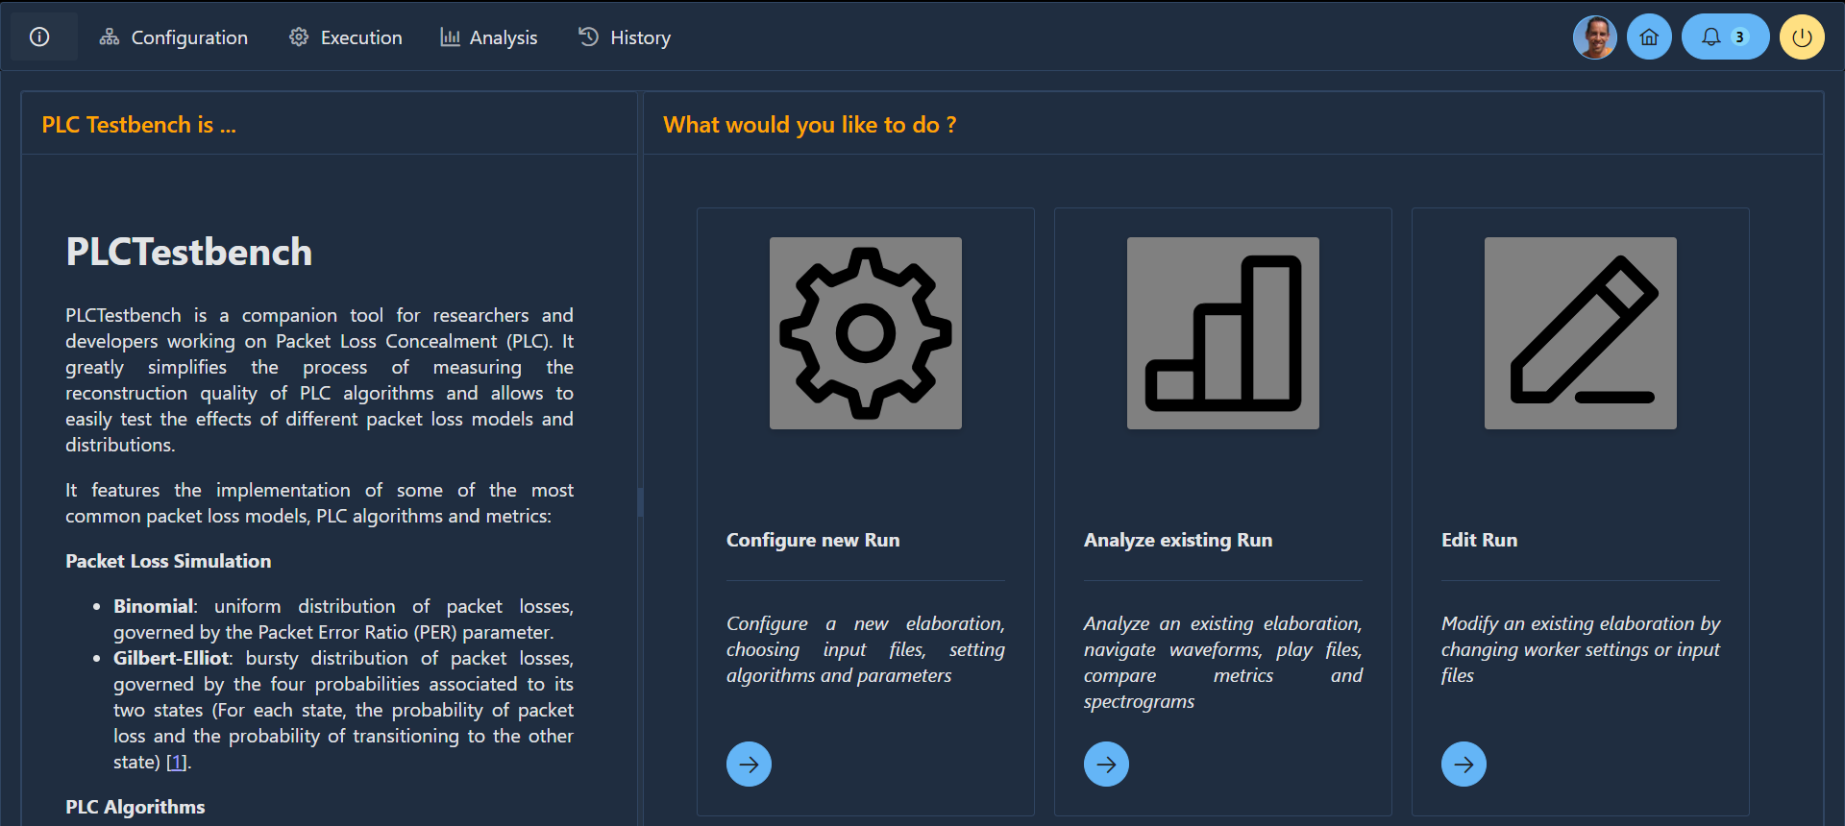
GUI - Landing Page

Slide 7
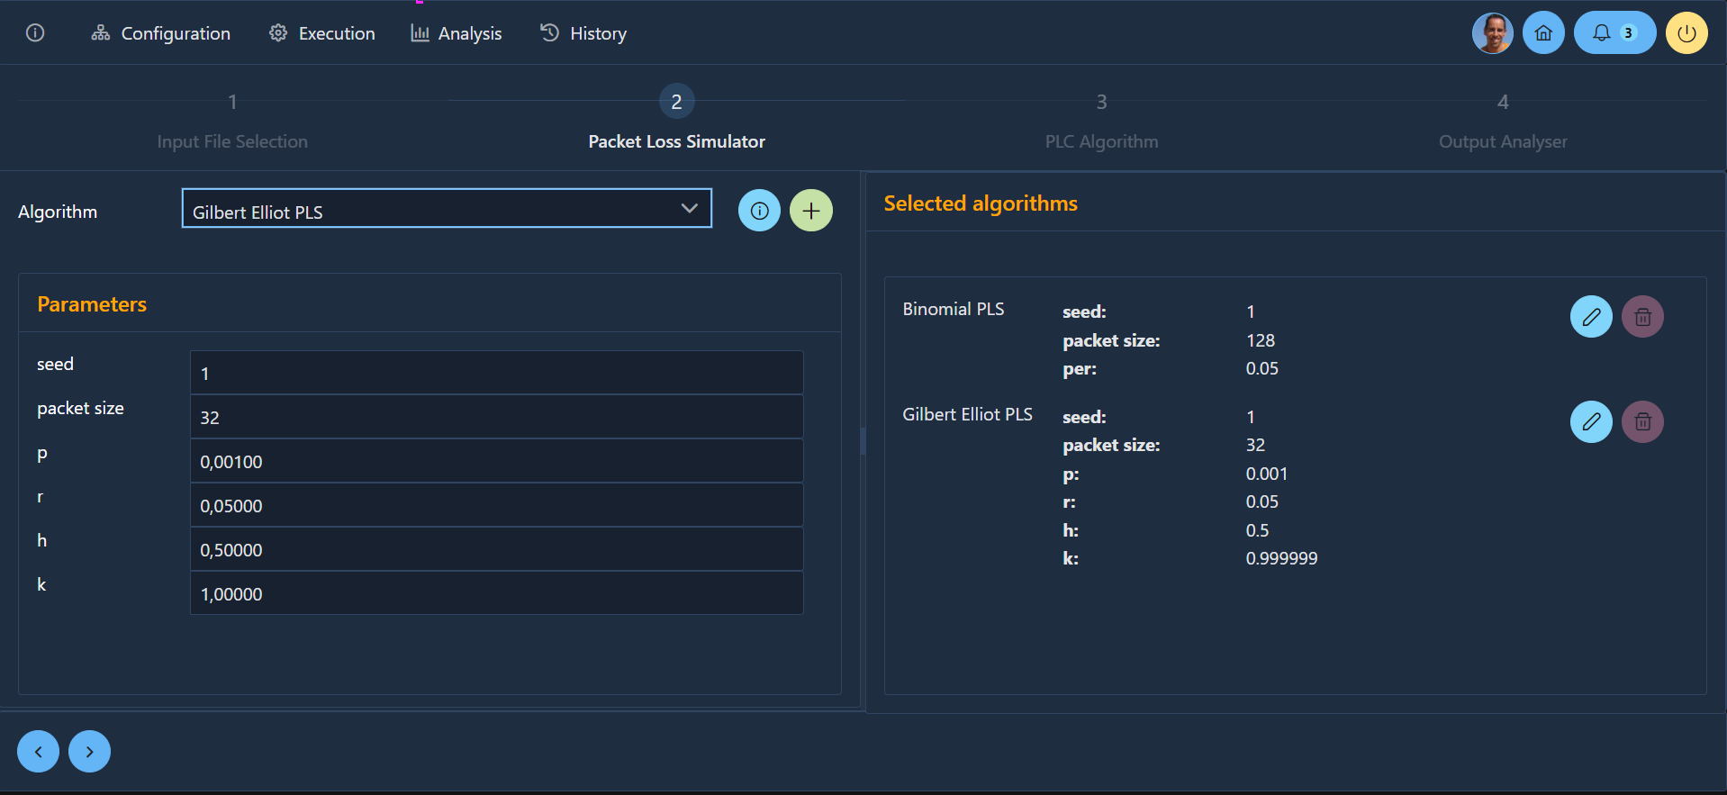
GUI - Configuration Module

Slide 8
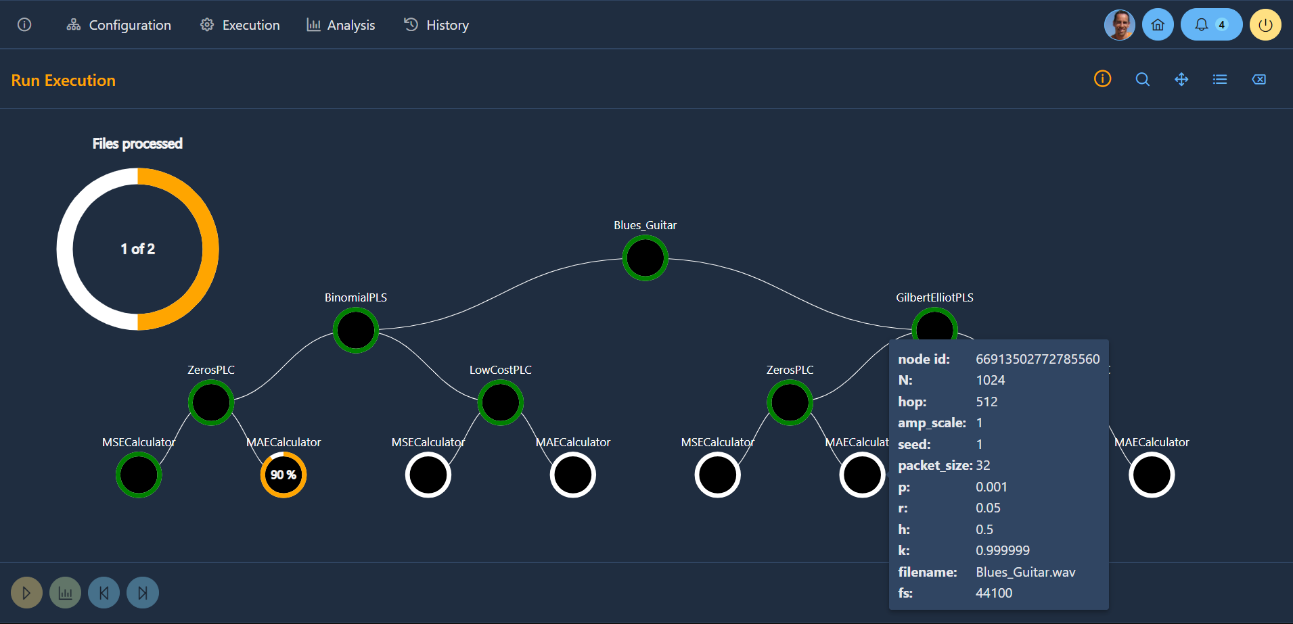
GUI - Execution Module

Slide 9
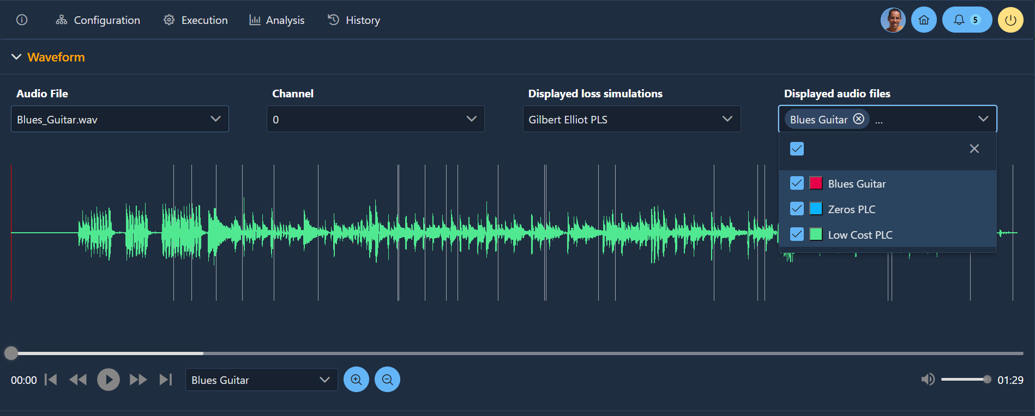
GUI - Analysis Module - 1

Slide 10
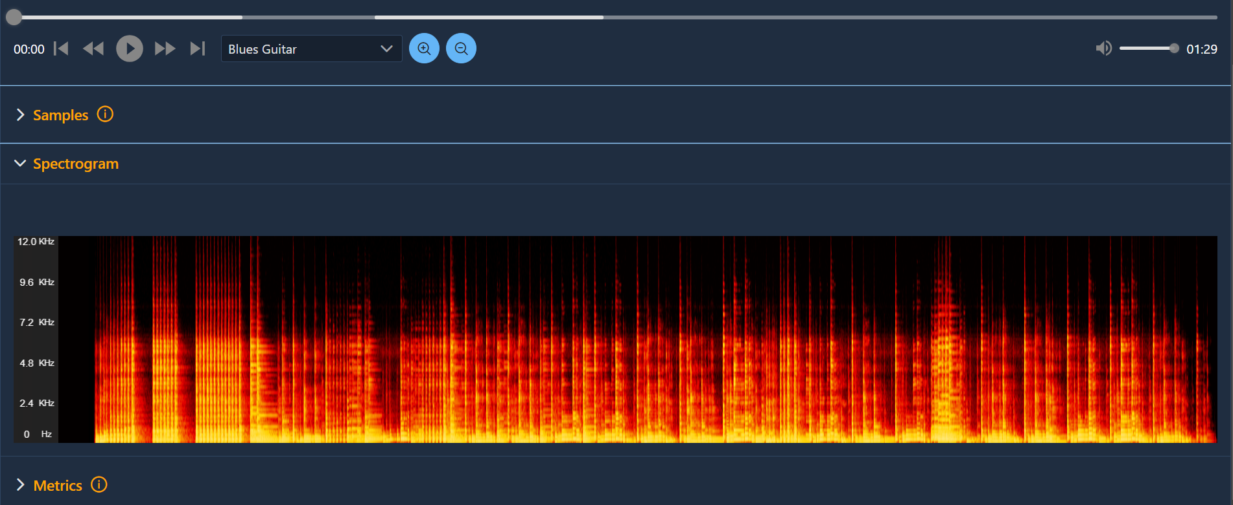
GUI - Analysis Module - 2

Slide 11
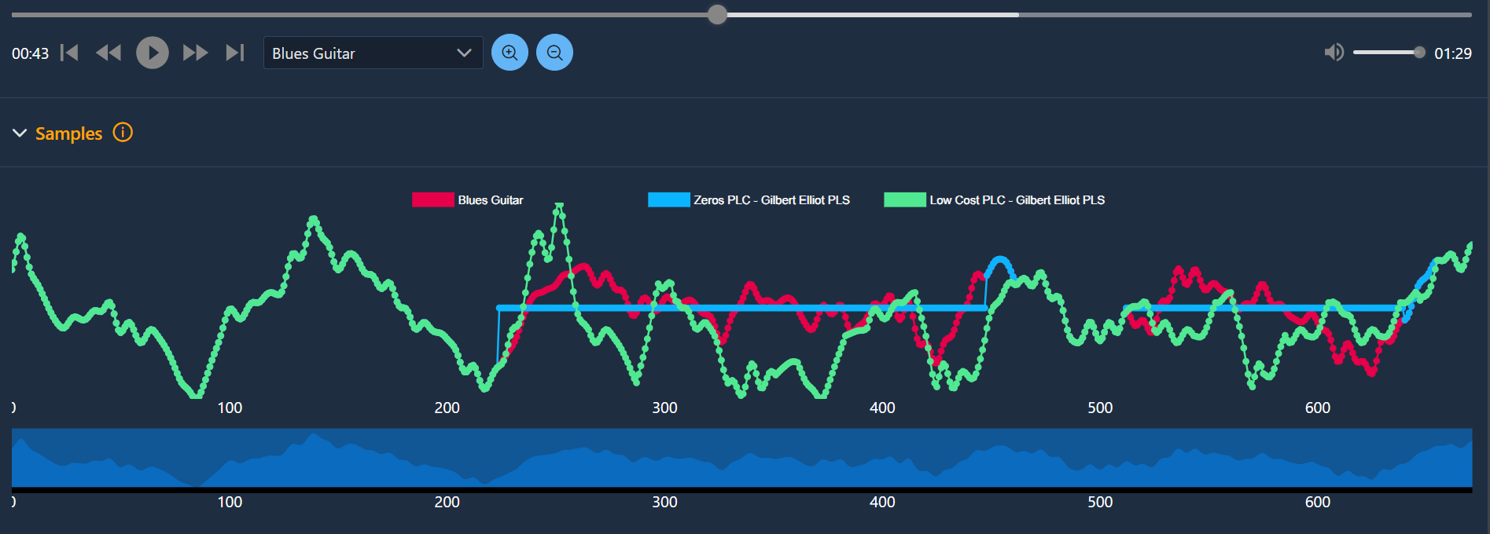
GUI - Analysis Module - 3

Slide 12
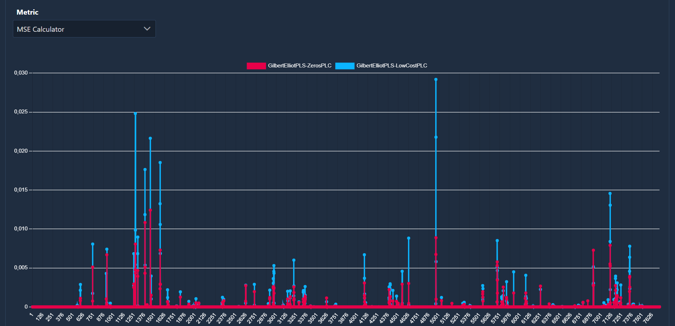
GUI - Analysis Module - 4

Slide 13
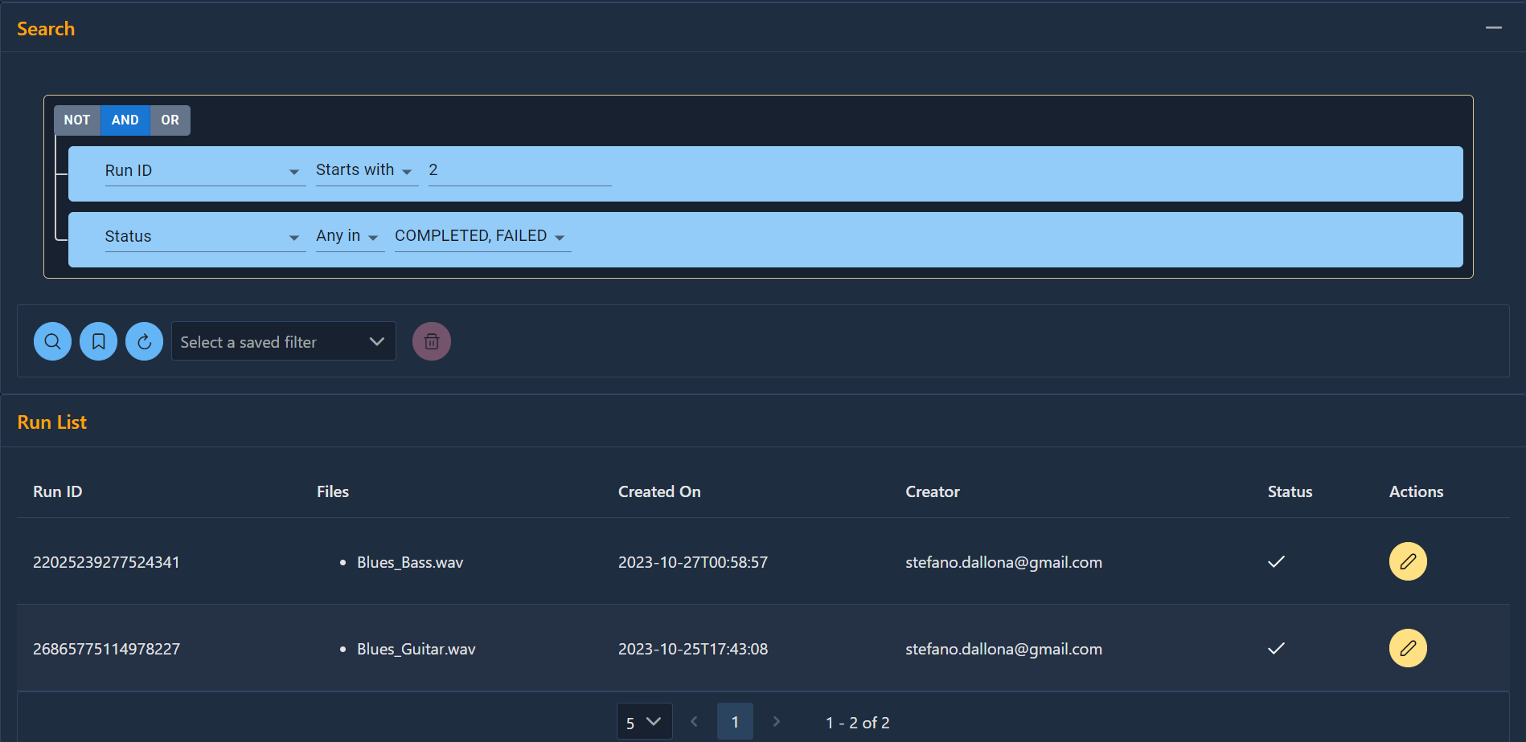
GUI - Search Module

Slide 14

Results
Benefits brought to the PLC Testbench tool
Easier installation
Less steep learning curve
Debug & validation
Scalability
Improved analysis
capability
Usage extension

Slide 15
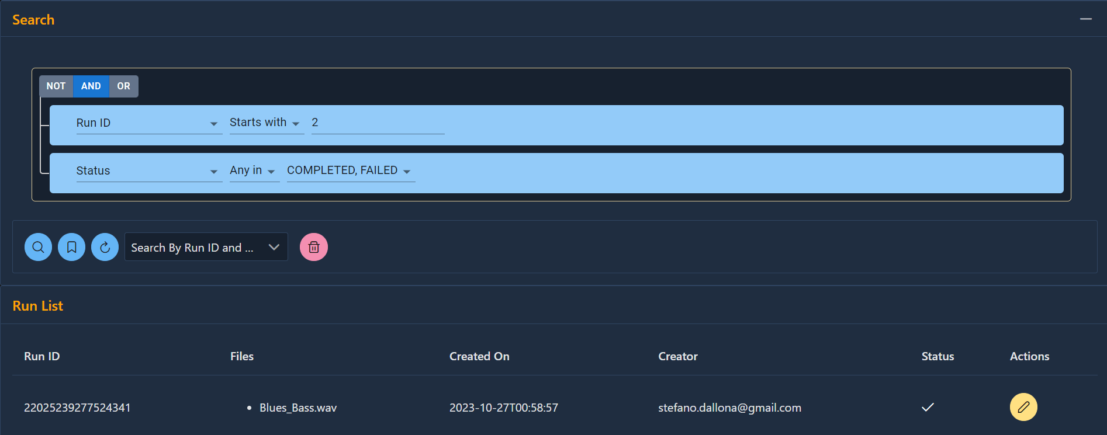
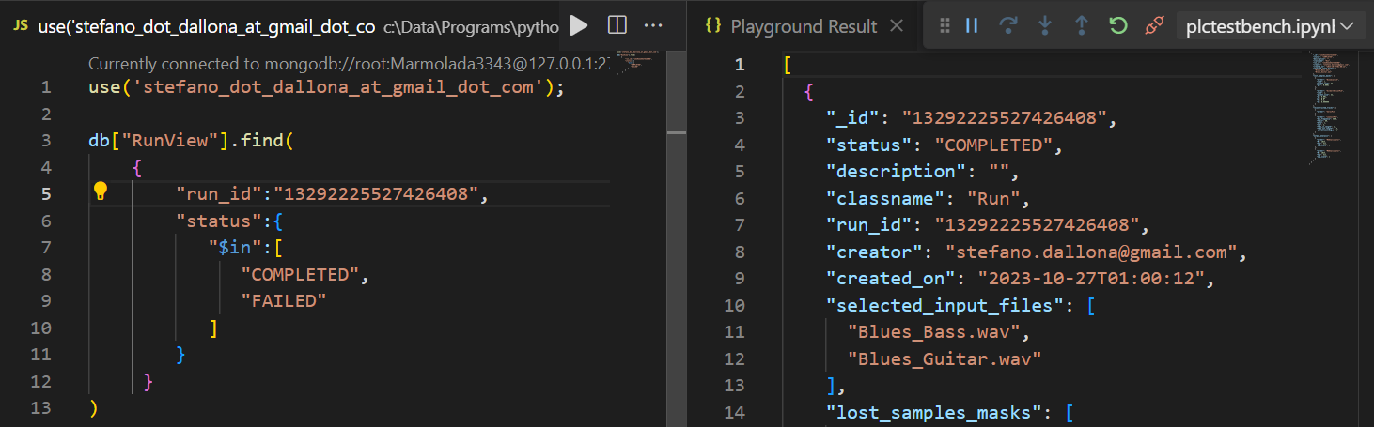
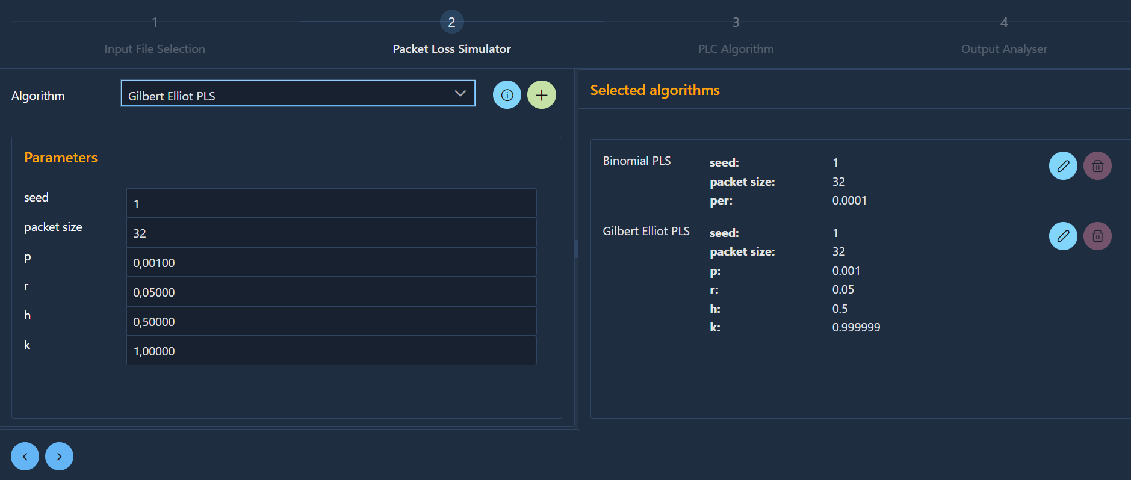
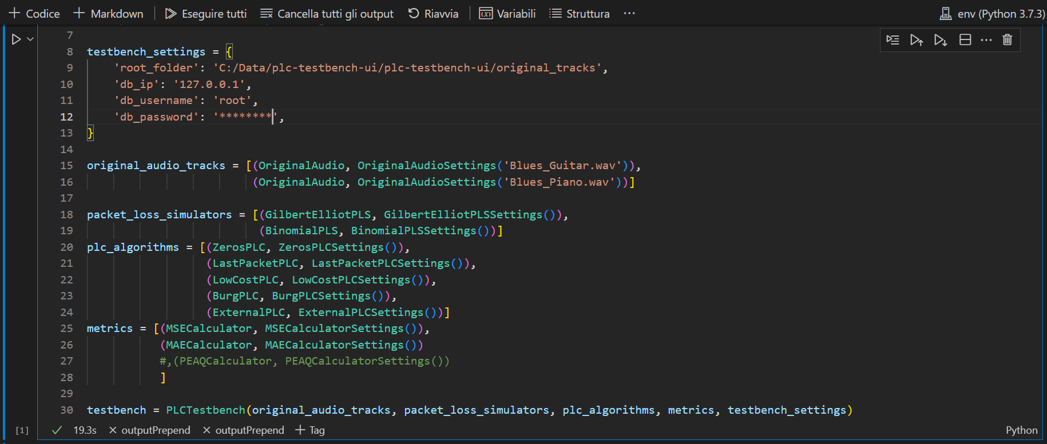
GUI vs Native Interaction - 1

Slide 16
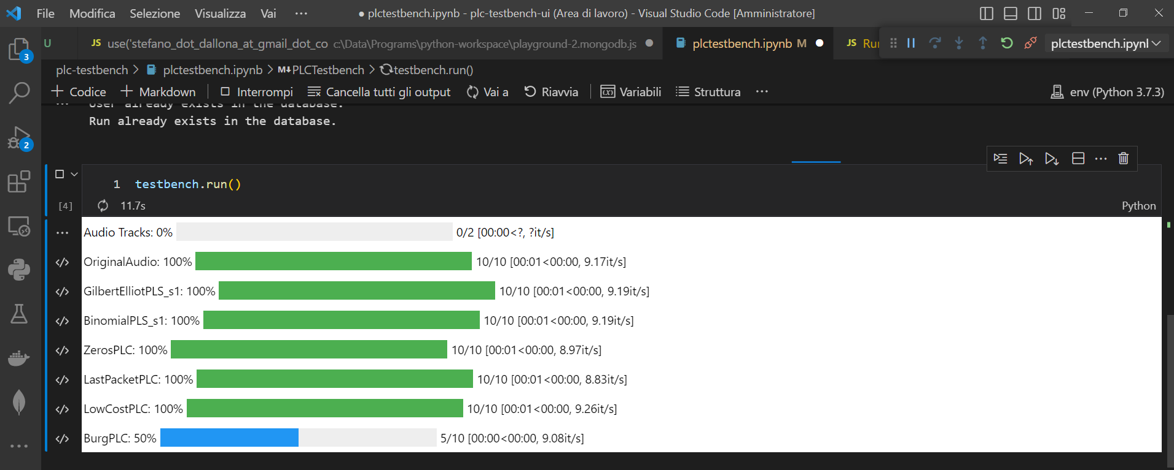
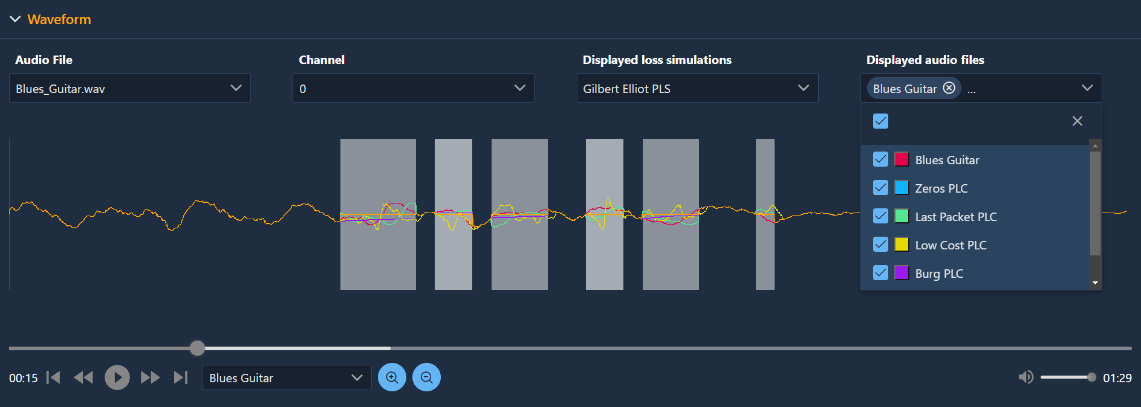
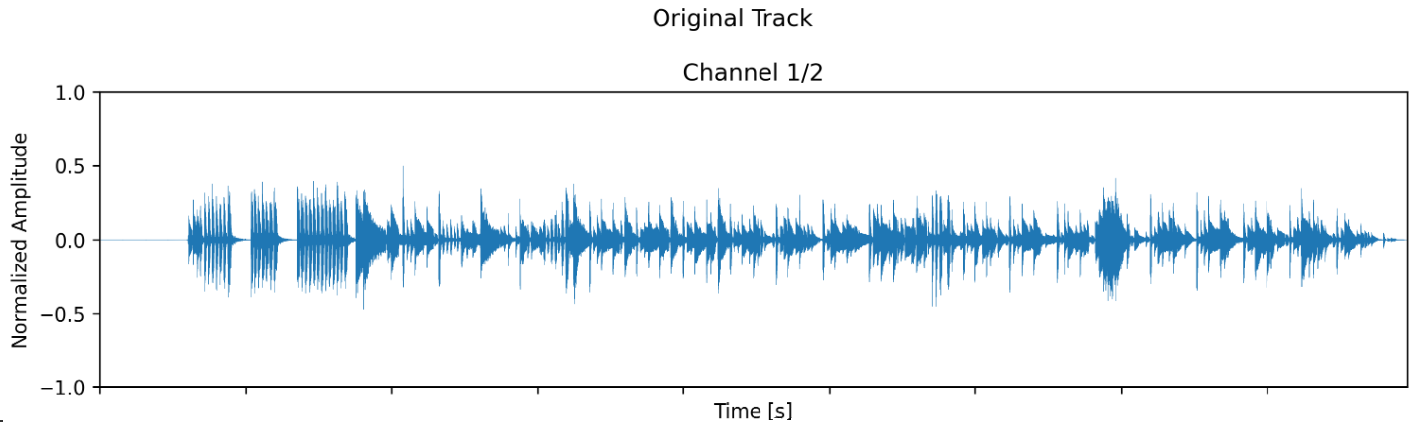
GUI vs Native Interaction - 2

Slide 17

Future Work
A few ideas
Support for additionals audio formats
Exposing logs
Search functions on output results
UI Themes
Support for additional languages
User collaboration use cases
Additional authentication & authorization methods
Data export

Slide 18

Conclusions
PLC Testbench
Native interaction
Web GUI
- limited and raw visual output
- no output integration
- programming-level interaction
- installation complexity
- sophisticated visual output
- highly integrated output
- graphical interaction
- installation ease

Slide 19

Acknowledgements
Thanks to
Prof. Luca Turchet
Ing. Luca Vignati
for the invaluable feedback
and support provided

Slide 20




References
 | GitHub repository of the project https://github.com/stefano-dallona/plc-testbench-ui public access
 | Docker image of the project https://hub.docker.com/repository/docker/stdallona/plc-testbench-ui public access
 | Paper presented at the IS2 2023 in Pisa 4th International Symposium on the Internet of Sounds https://drive.google.com/file/d/1kFY9Hj-G7mWJP7U3CpPZf9TR95M5tQGV/view?usp=drive_link restricted access

